Slide 1
Device Hardening

Slide 2
Device Hardening
Device hardening includes steps to secure a device from network- or software-supported attacks
There are many layers of defence you can implement

Slide 3
Updates and Security Patches
Updates to applications, OSs, and device firmware fix bugs, add new features, and close security gaps
Process of properly managing and applying security patches includes:
Discovery
Standardisation
Defense in depth
Vulnerability reporting
Implementation
Assessment
Risk mitigation

Slide 4
Administrative Credentials
Many devices are managed through remote access connections
Using SSH keys is more secure than using passwords
A securely encrypted key is more difficult to crack
Many devices offer the option to configure several administrative accounts with varying levels of access
Some user accounts are given privileged access
Security precautions that might be taken for these accounts include the following:
Limited use
Limited location
Limited duration
Limited access
Limited privacy

Slide 5
Services and Protocols
Insecure services and protocols should be disabled in a system whenever possible
To protect devices, follow these guidelines:
Reduce access paths
Choose secure protocols
Reduce start-up processes
Disable unneeded services
Declutter software
Streamline the network
Close unused ports

Slide 6
Passwords (1 of 2)
Hashing means to transform data through an algorithm that reduces the amount of space needed for the data
SHA (Secure Hash Algorithm) is the most commonly used hashing algorithm
Its primary advantage is its resistance to collisions
Versions of SHA:
SHA-0
SHA-1
SHA-2
SHA-3
SHA-2 and SHA-3 are often implemented together for increased security

Slide 7
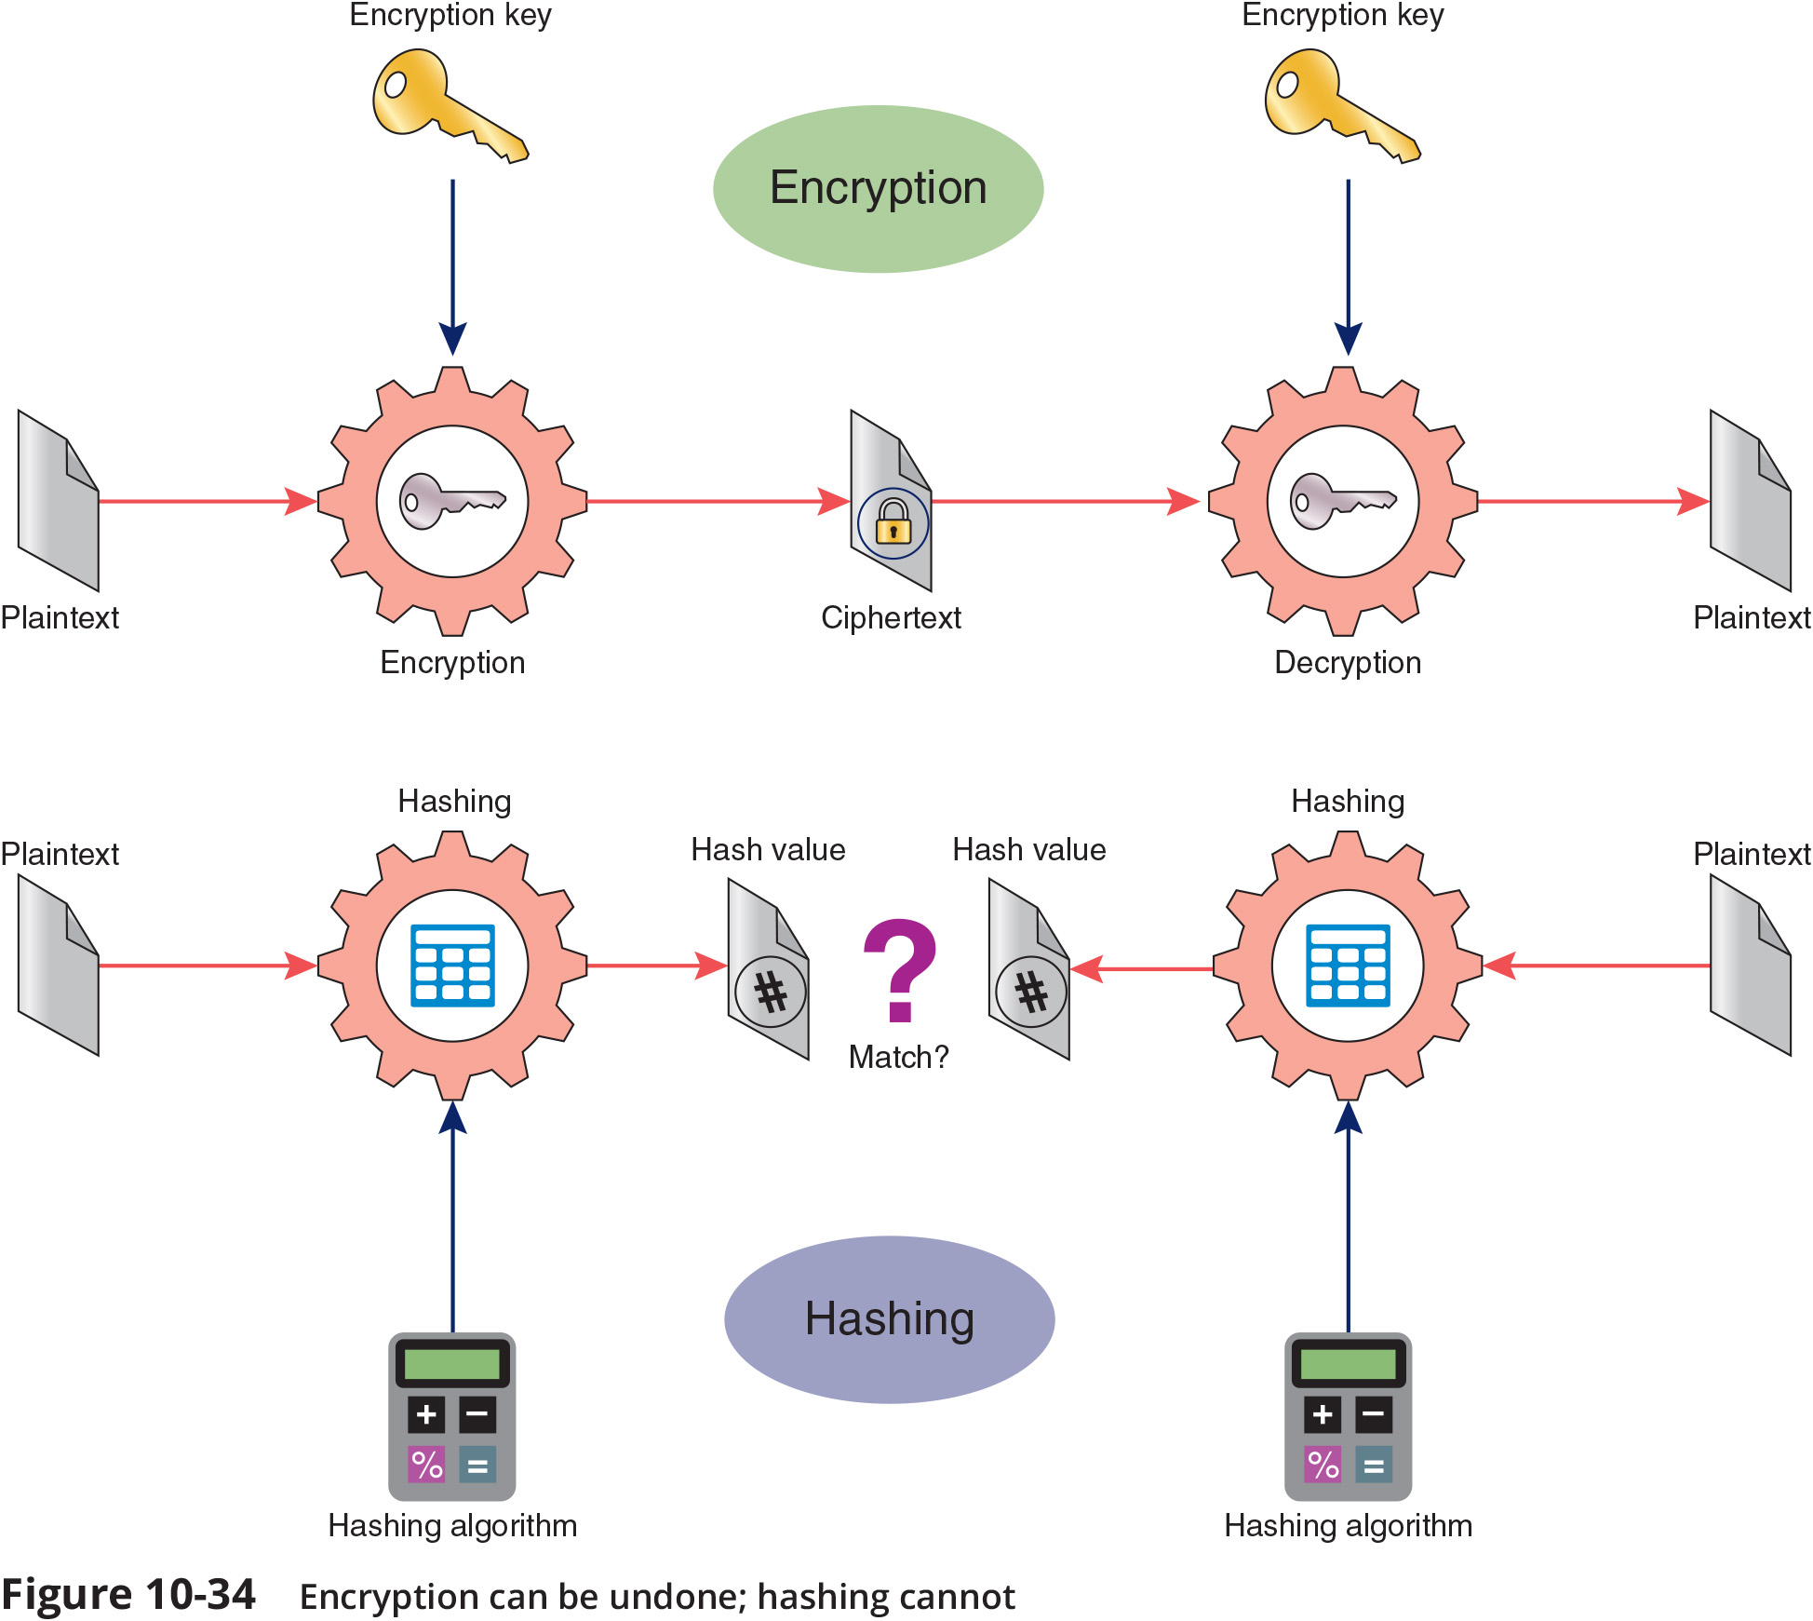
Passwords (2 of 2)

Slide 8
Anti-Malware Software (1 of 2)
Malware generally leaves evidence of itself
Some malware can be detected only via anti-malware software
Symptoms of malware:
Unexplained increases in file size
Significant, unexplained system performance decline
Unusual error messages
Significant, unexpected system memory loss
Periodic, unexpected rebooting
Fluctuations in display quality

Slide 9
Anti-Malware Software (2 of 2)
When implementing anti-malware software, one of your most important decisions is where to install software
Some scenarios include the following:
Host-based
Server-based
Network-based
Cloud-based
You must balance protection with performance impact

Slide 10
Asset Disposal
Mining data from discarded devices can yield significant insights into a company’s operations, proprietary systems, and sensitive data
Your company is legally responsible for the data contained on devices even after you stop using them
In many cases, companies will hire professional disposal services that adequately sanitise or destroy devices so no data can be recovered
These services often provide a CEED (Certificate of Electronic Equipment Destruction), which serves as legal protection should data later be recovered from your devices

Slide 11
Security Policies for Users
A security policy for network users identifies security goals, risks, authority levels, designated security coordinator, and team members, responsibilities of each team member and employee
A user security policy should not state which hardware, software, architecture, and protocols will be used to ensure security
An example would be setting a network-wide security policy that prompts users to change their passwords every three months

Slide 12
Security Policy Goals
Typical goals for security policies include the following:
Ensure authorised users have appropriate resource access
Prevent unauthorised user access
Protect sensitive data from unauthorised access
Prevent accidental hardware and software damage
Prevent intentional hardware or software damage
Create a secure environment in which the network and systems can withstand, respond to, and recover from threat
Communicate each employees’ responsibilities
Have employees sign a consent to monitoring form

Slide 13
BYOD (Bring Your Own Device)
BYOD (bring your own device) refers to the practice of allowing people to bring their smartphones, laptops, or other technology into a facility for the purpose of performing work or school responsibilities
Variations include:
BYOA (bring your own application)
BYOC (bring your own cloud)
BYOT (bring your own technology)
CYOD (choose your own device)
Part of a BYOD policy might include on-boarding and off-boarding procedures
These configurations can be handled automatically by MDM (mobile device management) software

Slide 14
AUP (Acceptable Use Policy)
An AUP (acceptable use policy) explains to users what they can and cannot do while accessing a network’s resources
It also explains penalties for violations
Some restrictions might include the following:
Use company resources to fulfill job obligations and not for personal tasks
Be aware that activities on the network can be and are monitored
Immediately report any suspected compromise of confidential data
Always sign off or lock a device
Don’t do anything illegal using company devices
Don’t try to circumvent network security restrictions

Slide 15
NDA (Non-Disclosure Agreement)
An NDA (non-disclosure agreement) is a document that defines what confidential and private means to the organisation
If you work in an environment such as a hospital, a security policy should classify information in degrees of sensitivity that correspond to how strictly its access is regulated

Slide 16
Password Policy (1 of 2)
Tips for making and keeping passwords secure include the following:
Change default passwords
Avoid personal information
Avoid real words
Long is strong
Increase complexity
Don’t use sticky notes
Update passwords
Don’t reuse passwords
Use a password manager

Slide 17
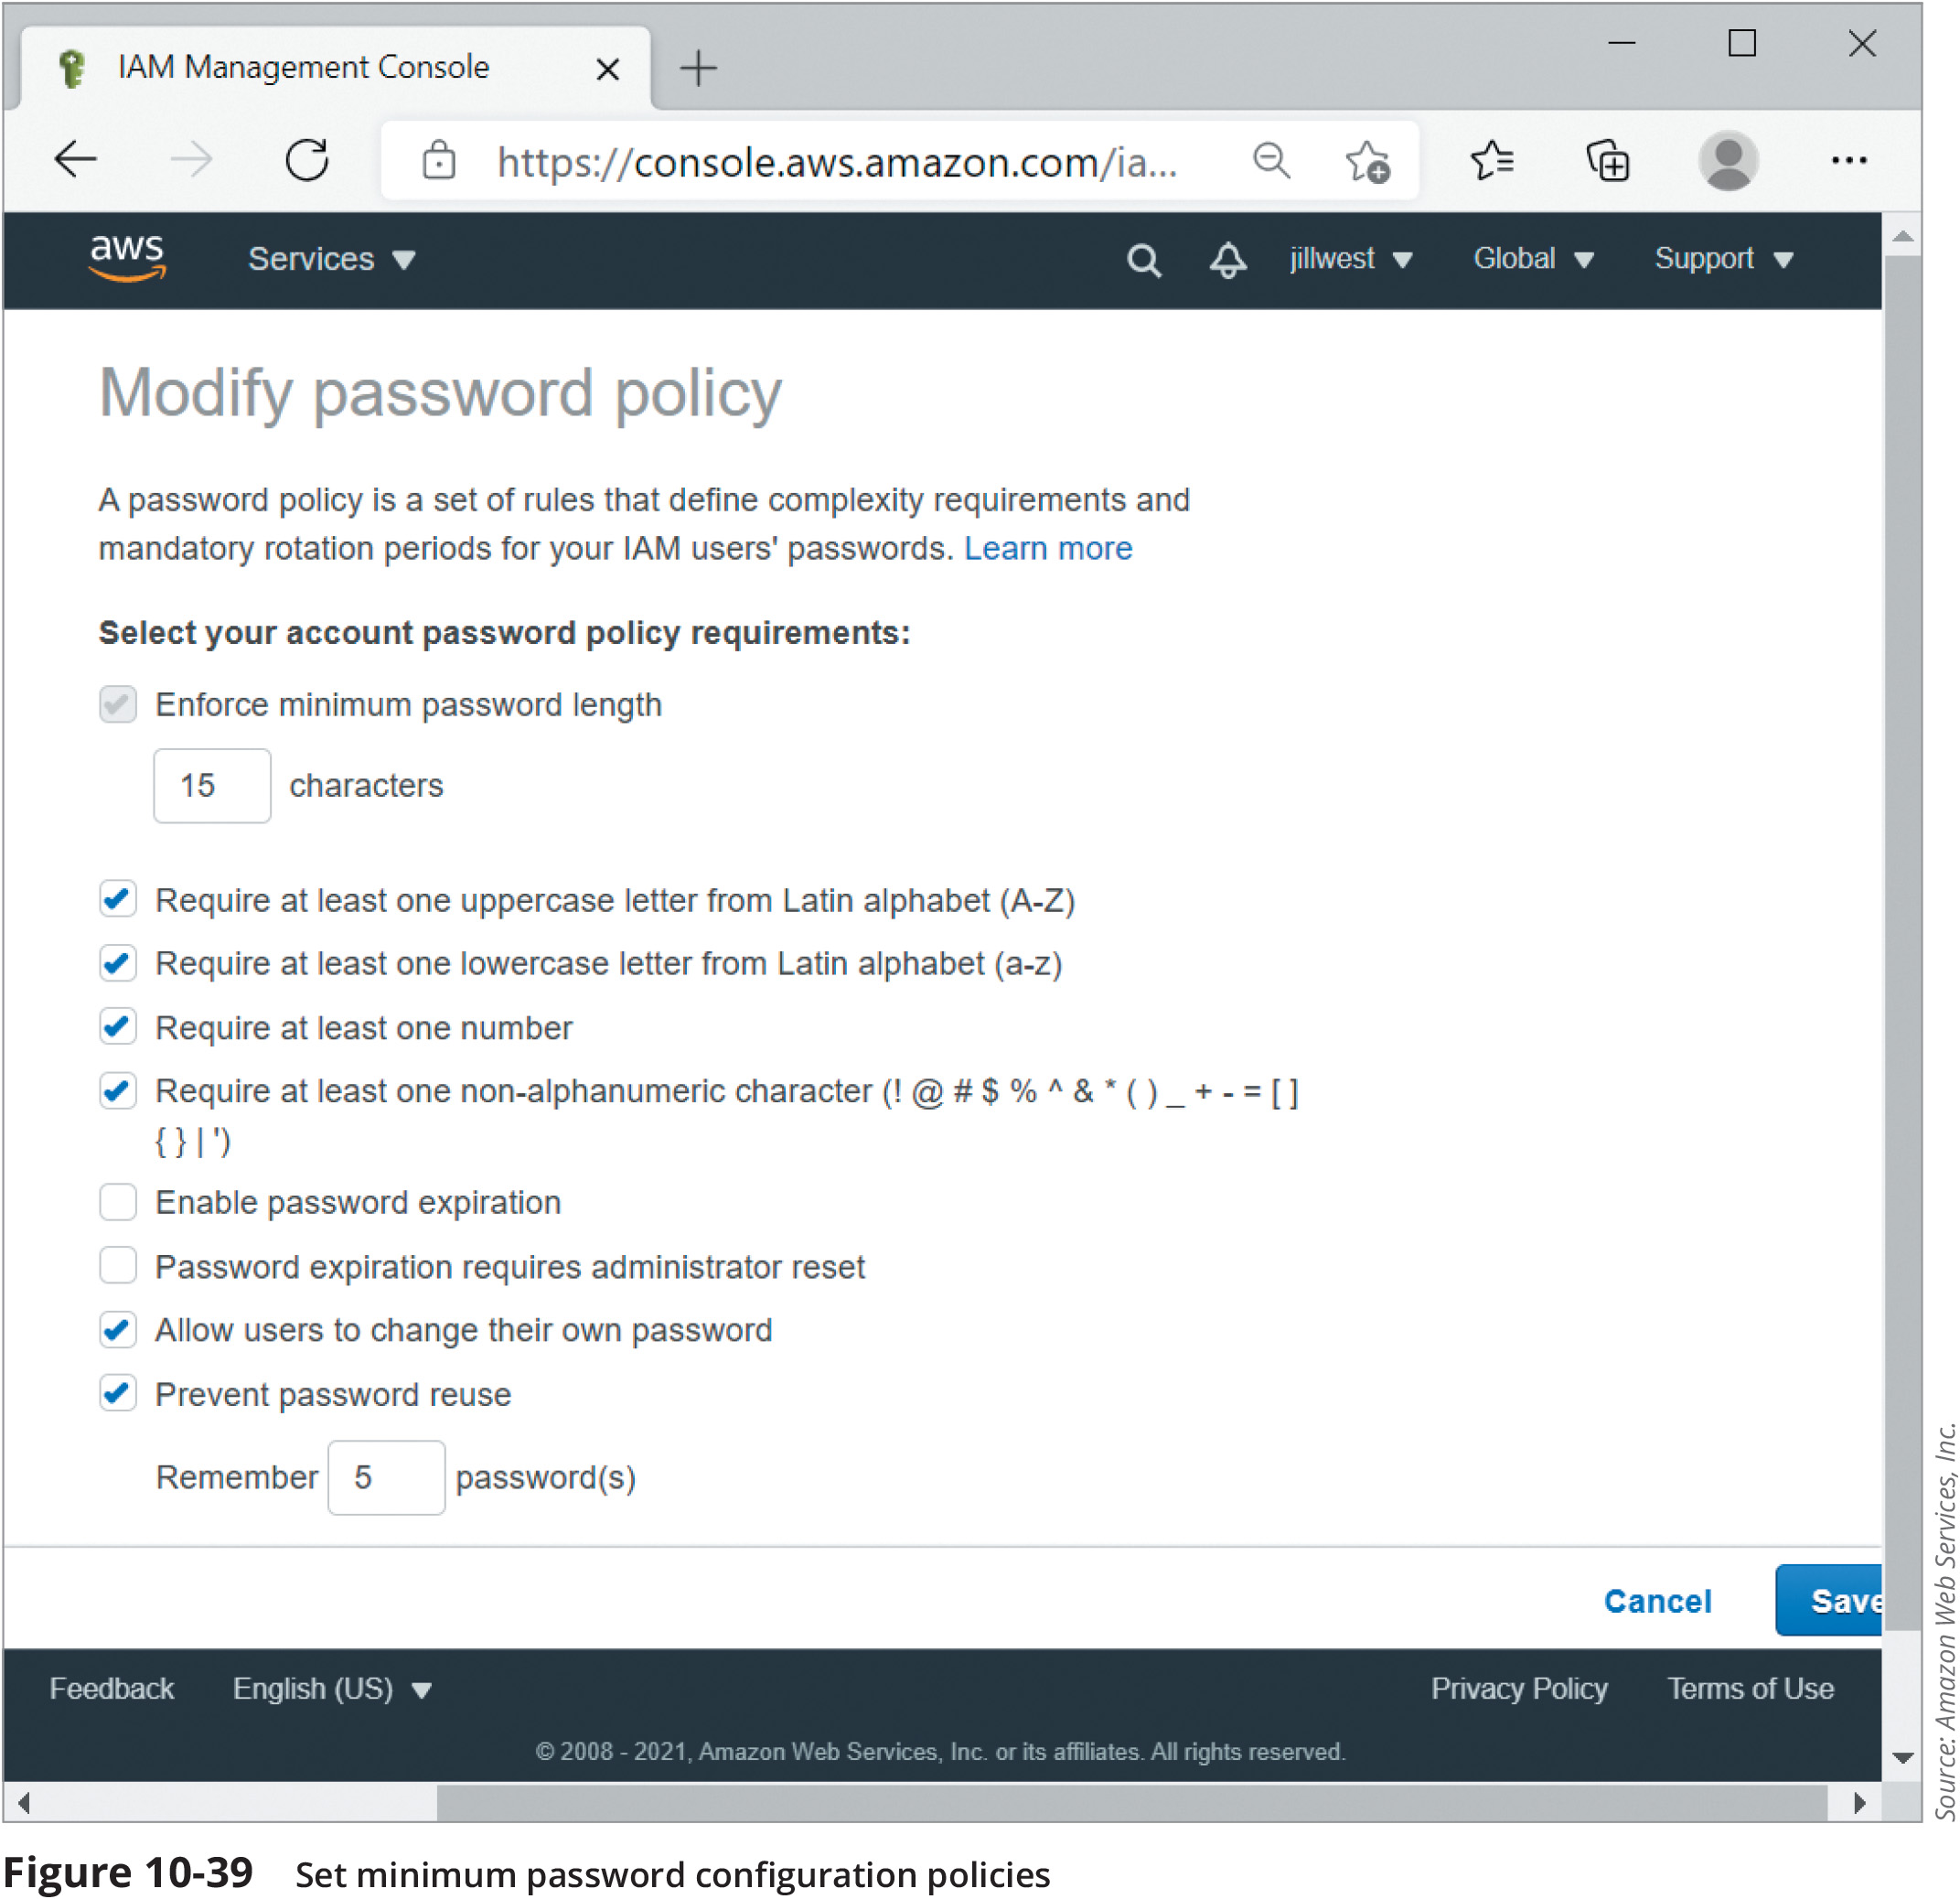
Password Policy (2 of 2)

Slide 18
Privileged User Agreement
A PUA (privileged user agreement) addresses specific concerns related to privileged access given to administrators and certain support staff
It outlines guidelines, rules, restrictions, and consequences of violations
When accessing a privileged account, the user should only stay signed into the account as long as is necessary to perform needed tasks and then sign off
Privilege users need more frequent training and reminders to avoid falling for social engineering attacks of various types
Privileged accounts may be monitored through a PAM (privileged account management) tool

Slide 19
Anti-Malware Policy
An anti-malware policy provides rules for using anti-malware software and policies for installing programs, sharing files, using external storage
Suggestions for anti-malware policy guidelines:
Every computer should be equipped with malware detection and cleaning software
Users should not be allowed to alter or disable the anti-malware software
Users should know what to do in case their anti-malware program detects malware

Slide 20
Anti-Malware Policy
Suggestions for anti-malware policy guidelines:
An anti-malware team should focus on maintaining the anti-malware measures
Users should be prohibited from installing any unauthorised software on their systems
System wide alerts should be issued to network users notifying them of a serious malware threat and advising them how to prevent infection

